Slide 1
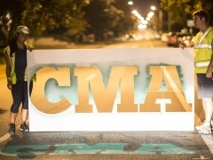
Massivemedia Media Kit
A few fun street level ideas
Mark Miller 561-707-0138 cell
Marilyn Miller 561-628-5807 cell
561-641-3501 office
www.oohmediausa.com
Mark@oohmediausa.com
Marilyn@oohmediausa.com
MASSIVEMEDIA

Slide 2
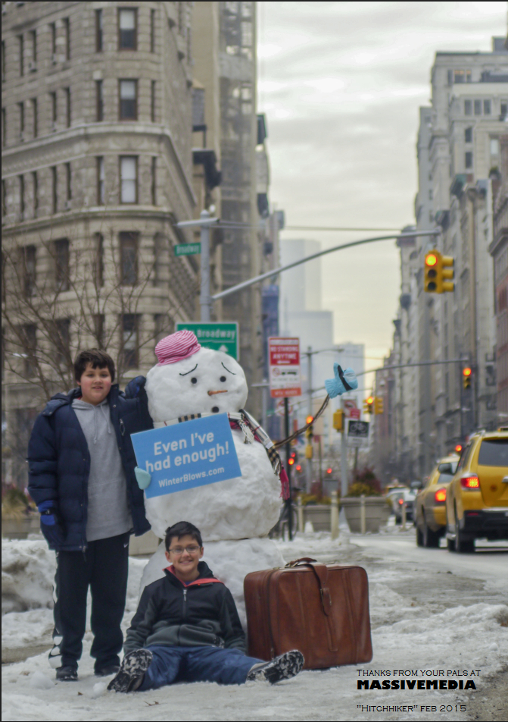
A few good experiential Ideas
MASSIVEMEDIA

Slide 3
Some cool options to introduce Massive
Massivemedia has created the following document to offer ideas that we think will work well for your upcoming projects. I hope it has some of the ideas that you need!
Our promotional booklet complete with program specifics and rates
can also be viewed by clicking on the following link:
https://issuu.com/massivemedia/docs/massivemedia_servicerates
Please feel free to contact us. We trust you will enjoy our work and we look forward to working with you.
MASSIVEMEDIA

Slide 4
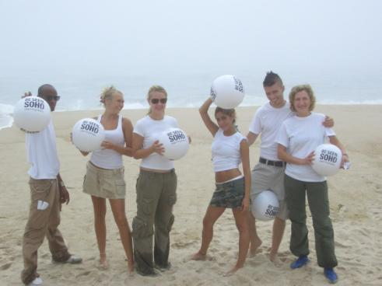
Distribution of Print Collateral or Product Samples
Massivemedia Spokesmodels deliver your message and engage consumers with Product Information in high-quality, energetic one-on-one encounters;
We can produce your premiums, print collateral and wearables to create a seamless, professional image for your brand.
Street Team of 4 Reps Full Shift (8 Hours):
Street Team of 4 Reps Half Shift (4 Hours):
MASSIVEMEDIA

Slide 5
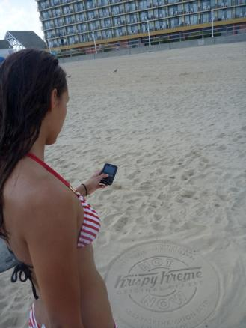
Sand Stamping – All beach cities
Massivemedia builds Buzz around sand savvy visitors through a turn key Beach marketing program
Our artists accurately deliver your message to the sand.
Installations are hand-stamped in specific areas of the market at specific locations and busy foot trafficked areas in the quantities requested;
Average Size: 32”
Program Cost, net per market:
300 pieces:
500 pieces:
750 pieces:
1500 pieces:
Stencil Production

Slide 6
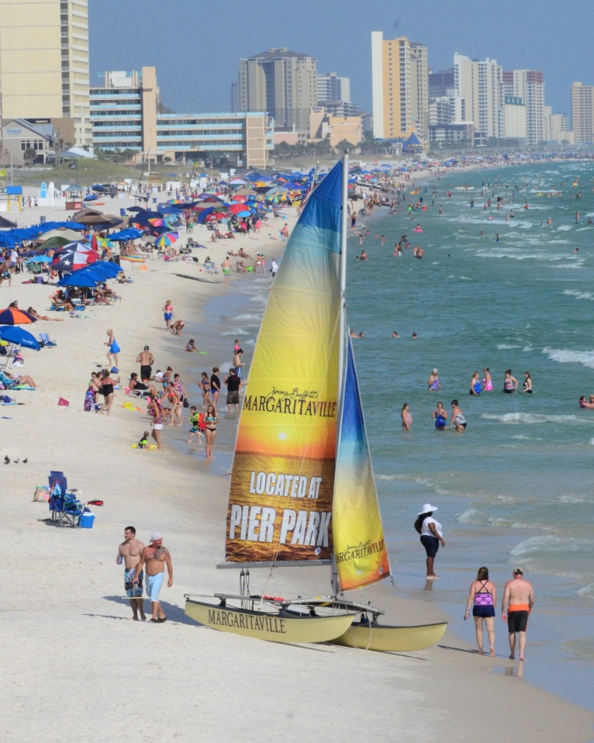
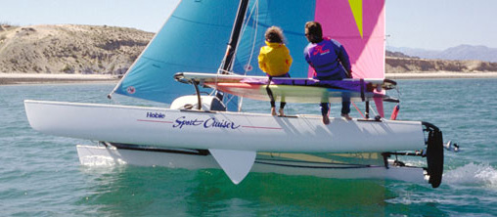
16 foot Hobie with 2 spokes models
Massivemedia will produce a fun Hobie cat and race it up and down the beaches stopping to interact with the beach goers! We can cover target beaches for 8 hours per day. Covering up to 20 miles of beach per day.
The program includes:
One Hobie Cat Billboard with 2 staff

Slide 7
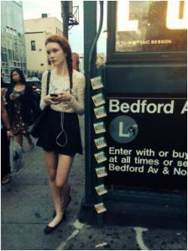
Magnet tagging
A magnet program is a much more friendly way to tag. The magnets easily come off and people know that they easily come off and will collect them and reposition them or take them home.
Massivemedia designs tagging programs that reach but clean up.
Repositionable: It will stick on any metal surface.
Economical: cost-effective compared to other print media.
Perfect as take-aways due to their non-destructive magnetic backing
Magnet Tagging Program includes:
Includes 4-color printing; die cut units are available at an additional cost
* all sizes are available, as well as custom die cut
Average size 3.5” x 3.5”
Program Cost, net per market:
2,500 pieces:
4,000 Pieces:
MASSIVEMEDIA

Slide 8
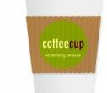
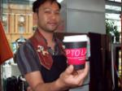
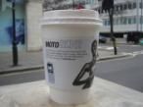
Coffee Cups or Sleeves
Give your brand premium presentation with custom printed coffee cup sleeves.
Experts strategically placed in high traffic locations in designated markets. We can target by market, ZIP Code, or other demographic parameters to efficiently place your message in the hands of your audience. We typically place 1,000 pieces per outlet.
The program includes:
Heat Insulated 3 Color Coffee cups or Sleeves
Option 1: 40,000 to be distributed in each market
Option 2: 20,000 to be distributed in each market
Option 3: 12,000 to be distributed in each market
MASSIVEMEDIA

Slide 9
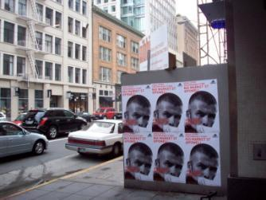
Grouped Wild Postings
We would also offer grouped wild posters hung guerilla style in all markets..
locations posted weekly for 2weeks with 2 to 6 to posters hung with staples and some instances glue.
Guerrilla Wild Poster Program includes:
Average size 24” x 36”
Program cost, net per market:
20 Locations 4-6 pieces per location:
30 locations 4-6 pieces per location:
50 locations 4-6 pieces per location: Larger sizes are available
Production of 400 posters– multiple markets can share printing costs as we use about
200 posters per market
MASSIVEMEDIA

Slide 10
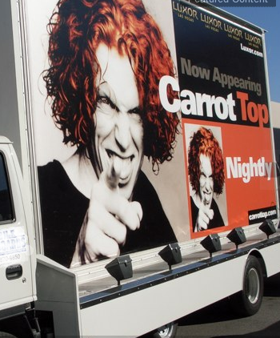
Mobile Billboard –
Mobile Billboards are the perfect way to get your message out on the streets and to the consumers.
Mobile advertising displays boost name recognition 15 times greater than any other form of advertising. Our mobile billboards will follow a designated schedule provided by your client, and they work at least an 8 hour day during prime viewing hours.
We will help design a program that will reach all of your target areas.
MASSIVEMEDIA

Slide 11
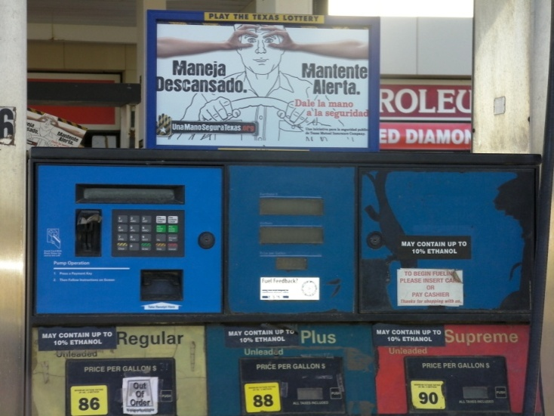
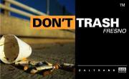
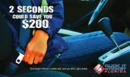
Gas Pump Topper Advertising
Massivemedia builds buzz among car savvy men and women via a turn-key Gas Station Marketing Campaign
Gas Stations are chosen to target specific demographics and maximize exposure
Additional items such as floor wraps. Interior signage, and window signage or Ice box wraps are available
- 2’ x 2’ floor graphic can be added for $50 per location. Production additional
-23” x 33.5” Window cling added for $90 per location. Production additional
Program 25 stations 3 2 sided units per station

Slide 12
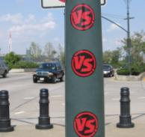
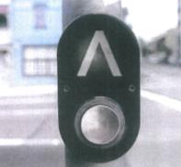
Sticker tagging
Massivemedia builds sticky buzz among savvy men and women via a turn-key Street Level Marketing Campaign
Following direction from the client, We will identify target areas and place stickers in ones and small clusters in the specified neighborhoods
Program includes Printing and Posting
Average size 4’ x 4’
MASSIVEMEDIA

Slide 13
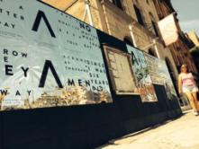
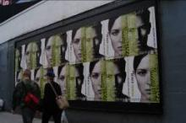
Wild Posters on permitted locations
Massivemedia will deliver a fully permitted wild posting program in the quantities described below.
Average size 36” x 24”
- 2 week flight two 3’ x 2’ posters per location
Los Angeles 40 locations
San Francisco 40 locations
Chicago 40 locations
Washington D.C./Balt. 40 Locations
Philadelphia 25 locations
.
Wild Poster Program in most other markets includes:
Program Cost, net per market:
30-40 Locations 1 -2 pieces per location:
Larger sizes are available
Production would be incremental - around $’s, pending the creative
Program will activate within 14 days of approval of artwork

Slide 14
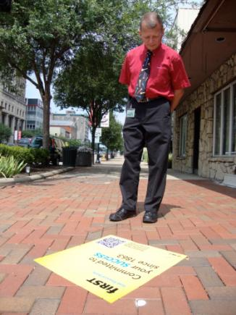
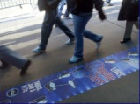
Sidewalk Minders
Massivemedia builds Sidewalk Sticker buzz in high traffic areas with a Sidewalk Minder program
Sidewalk minders are full color graphics that are quick to install and are perfect for getting an unexpected message to passersby without adding to the visual clutter.
Experts strategically place the minders in high traffic locations for a maximum of 2 weeks before removing them
Average size 2’ x 2’
30 pieces 50 Pieces
Although it is eco friendly, we still categorize this product as guerrilla and aggressive and suggest it is described to the client that way..
City authorization can rarely be obtained. We are happy to apply but governmental relations fees of approximately $2,500 shall apply.
MASSIVEMEDIA

Slide 15
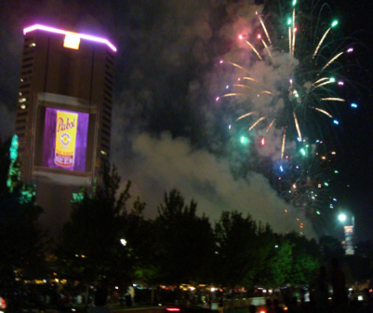
Projection Media Standard Pricing
Projection Media
3 Nights of Projection Media
Discount Pricing Available on any 5 nights within a 7 night period
Each Projection Team can cover up to three locations per evening
Projectors are HD and up to 20,000 lumens
Program Pricing
1 Projection team 3 Nights $3,750 per evening $11250 NET
2 Projectors 5 Nights $26,500 NET
Interactive Projection Units
Interactive Projection Unit - $3,000 additional per event week
High speed Connectivity
Texting program Pricing 5 days number included
Internet Microsite
Texting number and management $4,500 additional
These prices provide a turnkey video projection system streaming live off of a separately managed website.
Computer Programming Pricing
Development of any custom Projection or web interface billed at $75/hr
MASSIVEMEDIA

Slide 16
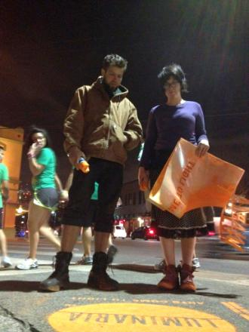
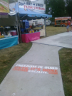
Sidewalk Stencil Art
Massivemedia builds buzz among street savvy men and women via a turn-key Street Level Marketing Campaign
Exciting and unexpected art pieces professionally applied lasting up to 6 months for a long lasting experience
Experts strategically place the art in high traffic locations confirmed
by the client guaranteed to reach the target.
MASSIVEMEDIA

Slide 17
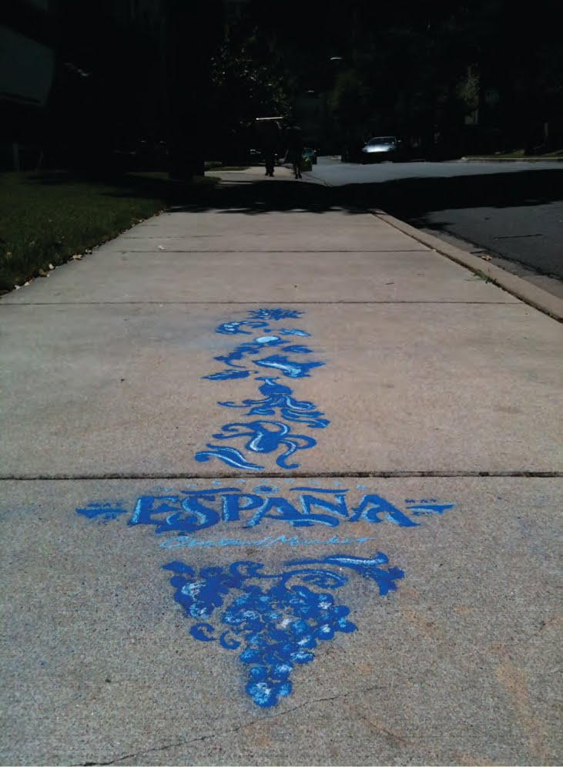
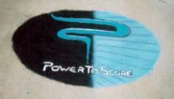
Chalk talk Sidewalk Chalk
Massivemedia builds Brand buzz among style-savvy men and women via a turn-key Street Level Marketing Campaign
Exciting and unexpected art pieces hand drawn professionally lasting a day to a week for a compelling experience
Experts strategically place the art in high traffic locations confirmed by the client guaranteed to make a good impression
Program includes:
Average size 48’ x 48’
MASSIVEMEDIA

Slide 18
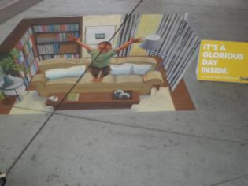
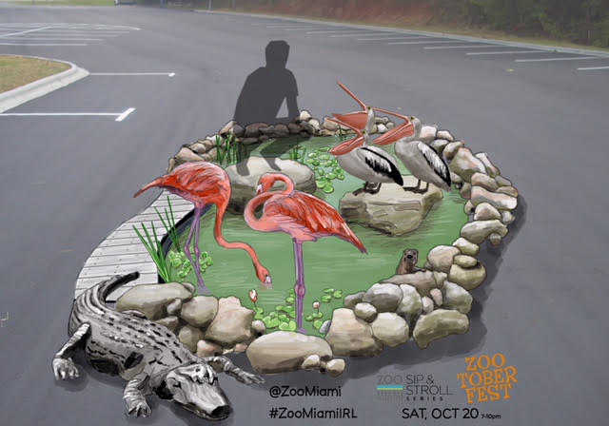
Sidewalk Chalk Art Spectaculars
Massivemedia will provide a turn key chalk art spectacular program including a professional artist to produce a Chalk Art Masterpiece program at your location. These one of a kind pieces will attract a curious crowd and deliver a high-impact media presence.
MASSIVEMEDIA

Slide 19
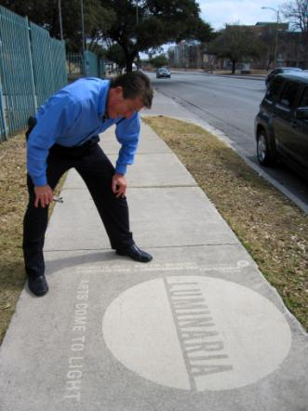
Green and Clean Powerwashed Ads
Massivemedia builds Brand buzz among eco conscious men and women via a turn-key Street Level Marketing Campaign
Exciting and unexpected art pieces created by the removal of dirt. The result is a contrast between the dirty street and the clean message.
Green and Clean is an environmentally friendly way of advertising on the street. Green and Clean is a refreshing way of advertising which is 100% environmentally friendly and can be targeted on busy areas. Green and clean has a detailed list of the busiest areas to guarantee a maximum exposure for your brand.
MASSIVEMEDIA

Slide 20
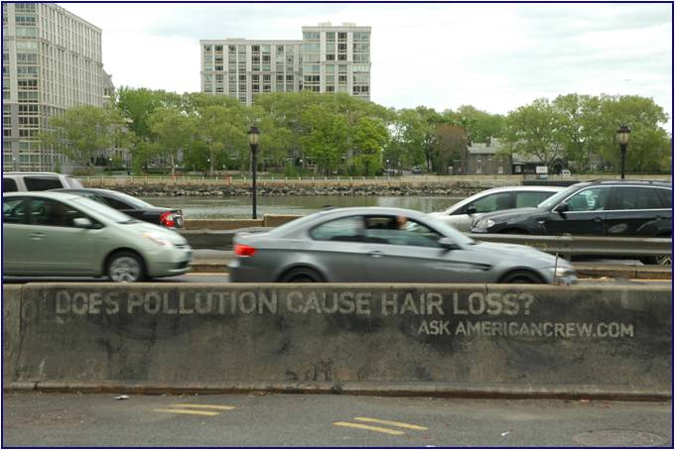
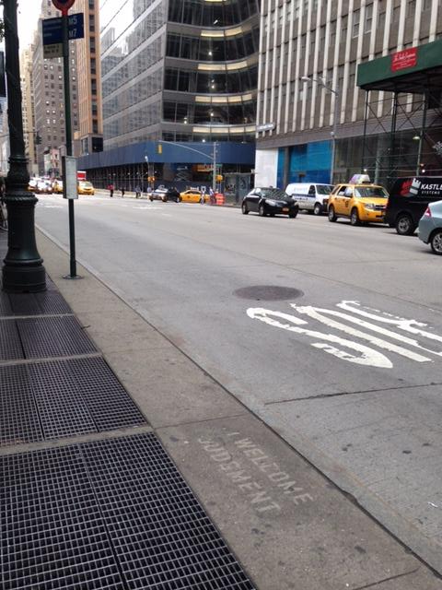
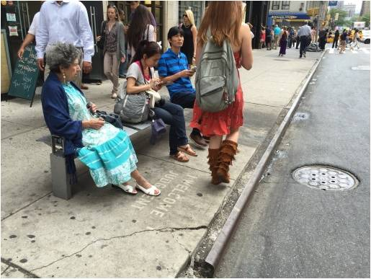
Green and Clean Powerwashed Ads
MASSIVEMEDIA

Slide 21
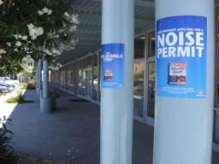
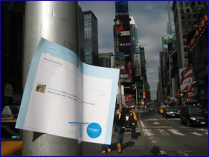
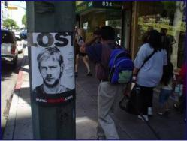
Flyer Posting
We will deliver a flyer program professionally and promptly. These “lost dog flyers” are printed sheets that can be posted either with staples or tape to effectively promote brand awareness for your clients
High Impact: put your message where it will be most effective.
Economical: cost-effective compared to other print media.
Flyer Posting / Pole Snipes Posters
* all sizes are available, as well as custom die cut

Slide 22
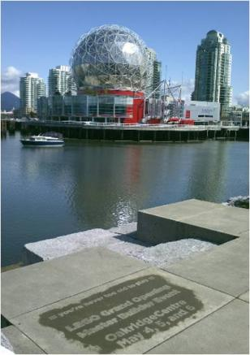
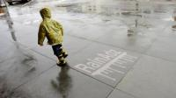
Rainadz Sidewalk imaging
Massivemedia builds wet weather buzz among soggy men and woman women via a turn-key Street Level Marketing Campaign
Rainadz turn a wet sidewalk into a striking display
Experts strategically place ads in high traffic locations confirmed
by the client intercepting the targets getting them to stop and stare.
Program includes:
Average size 36’ x 36’
Minimum Program 50 units

Slide 23
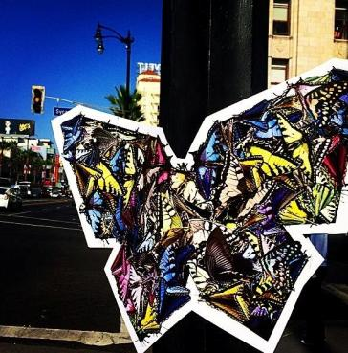
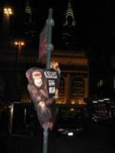
Pole sniping – shaped like hotdogs
Massivemedia can post the Pole signage on poles, bus stops and parking meters They can be placed in multiple groups or singularly.
Since they have almost unlimited placement options, wild postings provide an excellent blitz campaign for any type of advertiser.
High Impact: put your message where it will be most effective.
Economical: cost-effective compared to other signage
MASSIVEMEDIA

Slide 24
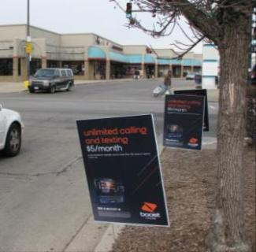
Road side lawn signs
Massivemedia builds road side buzz in high traffic areas with a lawn sign Minder program
Our roadside lawn signs are 2 color color graphics that are quick to install and are perfect for getting an unexpected message to passersby.
We place them on public and private property and they definitely get noticed
Average size 18” x 24”
Option 1: 75 to be distributed in each market
Option 2: 200 to be distributed in each market
Option 3: 500 to be distributed in each market
MASSIVEMEDIA

Slide 25
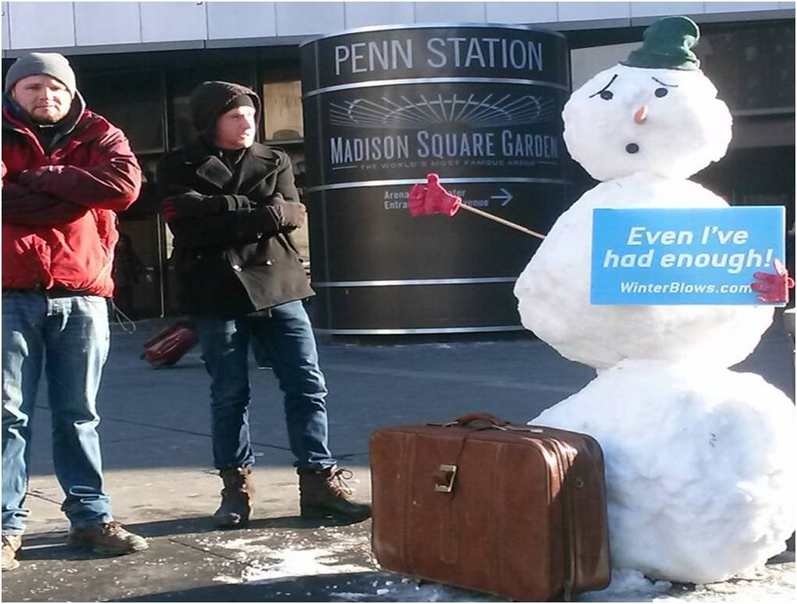
INSTORE NETWORKS AND OTHER GREAT IDEAS
MASSIVEMEDIA

Slide 26
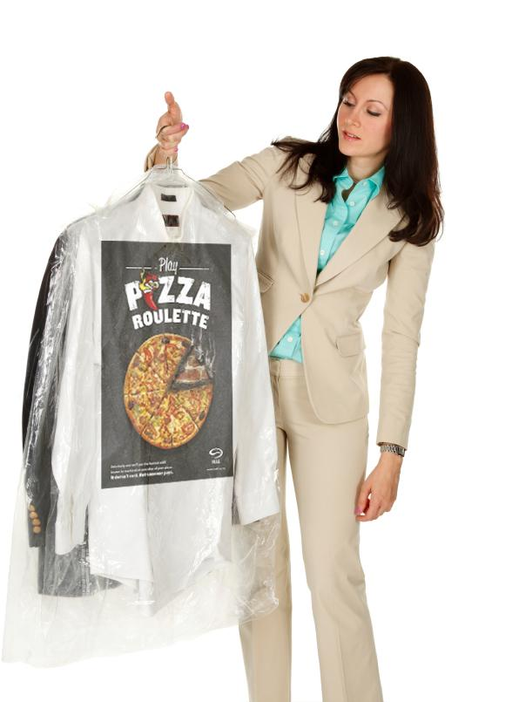
Dry Cleaner Ad Bags
Massivemedia will deliver a professionally manages drycleaner advertising program with a drycleaner bag program at Dry Cleaners targeting your exact demographic.
Program will include:
- One roll of approximately 600 drycleaner garment bags per location
1 Point of purchase display or window sign
Each roll will last approximately 45 days. A second roll can be added
Unit Size: 21 x 7x 40
2 color printing / 1 side
Discounts will apply when the program reaches 100 dry cleaners and 200 dry cleaners
MASSIVEMEDIA

Slide 27
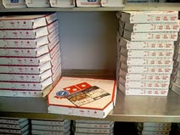
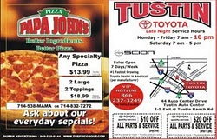
Pizza Toppers in Chain Restaurants Pricing Proposal
Package 1: 10 pizza places per market
Package 2: 25 pizza Places per market
Package 3 50 Pizza Places per market
Ads are ½ page ads and Dominoes, Papa Johns, or Pizza Hut get half of that. 81/2” x 11” are available at a 15% premium
Additional sizes are available. 10,000 pieces per outlet.
MASSIVEMEDIA

Slide 28
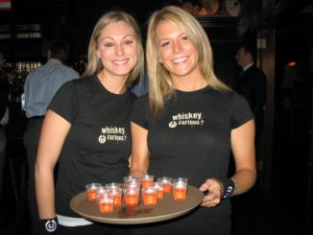
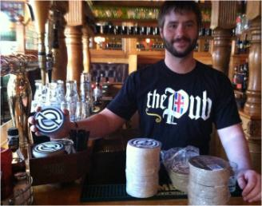
Coasters and Other in Bar Options
Massivemedia can produce and coordinate an In-bar marketing effort that will target specific restaurants with bars that will reach the clientele you are addressing. When patrons enter the bars they will be surrounded by your clients branding including in bar napkins and coasters.
A standard 10 bars per market program can be increased to reach a wider target. We can also add posters, glassware, and other custom options.
Program includes:
production and delivery of 1000 coasters to each selected bar
MASSIVEMEDIA

Slide 29
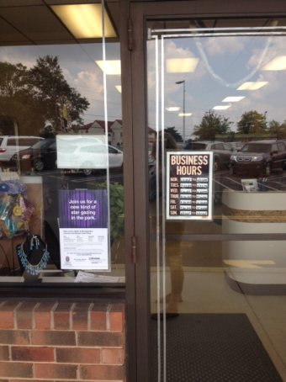
Window board Instore Posters
“Massivemedia builds buzz with an in store postering program targeting stores cleaners and delis around the market.
Marketing experts target specific neighborhoods and lifestyles to reach your target.
Posters are installed with the store owners permission and time is taken with each store owner to make sure they understand our product
In store posters are legal, long lasting, and have a great reach with each averaging over 500 to 5,000 potential viewers each day
Instore poster Program includes:
Includes 4-color printing; die cut units are available at an additional cost
* all sizes are available, as well as custom die cut
Average size 10” x 15”
Program cost, net per market:
250 pieces:
400 pieces:
MASSIVEMEDIA

Slide 30
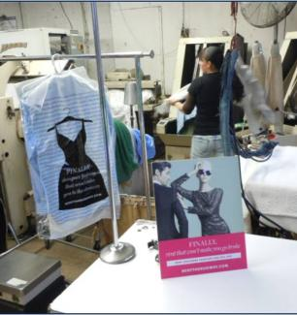
Instore Counter Cards
“Massivemedia builds buzz with an instore Counter Card program targeting stores Boutiques and other stores confirmed by the client.
Marketing experts target specific neighborhoods and lifestyles to reach your target.
Counter cards are installed with the storeowners permission and time is taken with each storeowner to make sure they understand our product
Instore Displays can include pockets for take ones and will manage the program for an additional fee.
Instore Counter card Displays
Includes 4-color printing; die cut units are available at an additional cost
* all sizes are available, as well as custom die cut

Slide 31
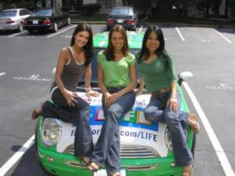
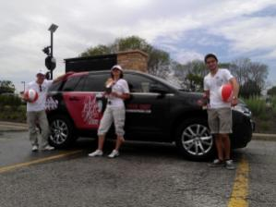
Wrapped Vehicles and Spokesmodel team
Custom Branded & Designed Vehicles
Custom wrapped vehicles are an excellent way to increase presence and provide a far-reaching message for your grand opening. From cute minis to Sport Utilities to the Rugged Humvees.
The vehicle(s) can be available for use by the client for eight hours each day. (Overtime billed at an hourly rate)
.
We propose a custom Branded Jeep or similar vehicle and 2 Models weekly or monthly.
MASSIVEMEDIA

Slide 32
Snow Stamps
Our Snow Sculpture experts will make really cool Stamps and stamp them everywhere in targeted areas immediately after a fresh snow fall.
These thanfreeze in and last till the next snow!
Average size 30”
- Could be super fun and we can break a program into a few months to save budget!

Slide 33
Press Snow Sculpture
Massivemedia’s Snow Sculpture experts will make really cool stuff.
If there is no snow we can bring it $7,500 extra
Can contract Real Estate - $10,000 extra

Slide 34
Magnet tagging
A magnet program is a much more friendly way to tag. The magnets easily come off and people know that they easily come off and will collect them and reposition them or take them home.
Massivemedia designs tagging programs that reach but clean up.
Repositionable: It will stick on any metal surface.
Economical: cost-effective compared to other print media.
Perfect as take-aways due to their non-destructive magnetic backing
Magnet tagging
Includes 4-color printing; die cut units are available at an additional cost
* all sizes are available, as well as custom die cut
MASSIVEMEDIA

Slide 35
SPECIAL INSTALLATION – ICE SCULPTURE
We will create “ice sculptures” as a “Special Media Installations”;
We can create Custom Ice Sculptures that will be created off-site and will be visible from creation to final meltdown We will put them out the night before and they can be on the beach or boardwalk in the am.
We can “light” the sculptures with LED Lighting for a slight additional charge. Printed messages or items can be frozen inside – How about your brands products and giveaways frozen in a block!

Slide 36
Sun dance Quarter Drop Program
Massivemedia shall deliver a program where 500 quarters branded with stickers dropped at approximately 1000 locations around a ,small area such as a jpark city.
Quantities can be adjusted
MASSIVEMEDIA

Slide 37
: Wrapped Hot Chocolate Truck
To create a more fun, family friendly experience for our neighbors, We will wrap an ice cream truck and distribute Hot chocolate to professional kids of all ages at local hotspots, parks and all the popular haunts.
This truck can have as many games and activities on it as we can create! We could have screens with the art going around the outside!
Recommended Package:
20 event days over the February and March stopping at multiple locations / day

Slide 38
Instore sampling experience
Massivemedia has over 20 years experience providing supermarket advertising programs including signage, product placements, inventory management, sampling and more. In fact, Many of our companies we proudly serve are supermarkets !

Slide 39
Tour Experience
Massivemedia has years of program tour experience. The Madewell Denim Roadtrip was a budget friendly 13 city tour. The trailer was outfitted with a hair-braiding bar, styling stations, and, of course, Products!. At each stop. women were invited inside the tour bus for professional consultations and fittings. Our event stop locations were designed to both hit Madewell stores and important high traffic fairs and festivals to increase reach! As you can read in the blogs below, the program was a huge success.
http://www.masslive.com/fashion/index.ssf/2012/04/madewells_denim_road_trip_tour.html
http://www.looksharpsconnie.com/2012/05/taking-candy-from-strangers-in-trucks.html

Slide 40
Recommended program 1: Restaurant and retail countercards with tearpads
We recommend a POP program where we place countercards with tear pads in restaurants and select high traffic retail locations. This program will provide the low cost coverage you require to meet the reach and frequency goals of the campaign.
Program includes:
High quality easel backed countercards with attached tear pad.
Replacement tear pads
Option 1: 200 to be distributed in each market
Option 2: 500 to be distributed in each market
Option 3: 1,000 to be distributed in each market
Cost:
Option 1: $5.000
Option 2: $10,000
Option 3: $19,000

Slide 41
IN WINDOW DISPLAYS
Massivemedia will place your message in the windows directly surrounding high traffic areas of the harbor and throughout the Area where all the action is in leased locations
The typical program includes:
In window displays
Minimum of 2 units
Lease, installation, removal
Production charges are additional; TBD at this time.
In-Window Monthly average Rate: $13,000 for 2 storefronts
Total estimated Program Cost: $20,000
MASSIVEMEDIA

Slide 42
Gas Pump Toppers
We place Gas Pump Toppers with tear pads in target locations
Custom Placed media
Fully targetable
This program was exclusively for Stations in Spanish speaking areas.
Option 1: 10 Gas Stations
Option 2: 25 Gas Stations
Option 3: 40 Gas Stations

Slide 43
ATM Toppers
We work with a strong network of high traffic convenience stores across the country and supply ATM Toppers in high traffic stations in your market.
Custom Placed media
Fully targetable
.
One Sheets, Floor or window signage, convenience store options and Ice boxes are all available as add on
Package 1: 100 outlets per market Package 2: 150 outlets per market
Package 3 250 outlets per market

Slide 44
Laundromats Mini domination
Massivemedia builds buzz with a Laundromat mini domination program around the market.
Mini posters are installed on 8 machines and 2 aisle minders are placed. Time is taken with each employee to make sure they understand our product.
Take one dispensers and other options are also available. The photo shows a 16’ x 20” framed panel substituted for the floor aisle minder.
Program includes:
2 Aisle Minders 18” x 28” 8 Miniposters 7” x 7”
Option 1: 10 outlets
Option 2: 25 outlets
Option 3: 40 outlets
Add ons:
L

Slide 45
Restaurant Countercards with tearpads
We place custom countercards with tear pads in target locations for MetroPCS.
Custom Placed media
Fully targetable

Slide 46
Convenience store Take-over
A great inexpensive way to provide brand coverage in a neighborhood
Experts strategically placed in high traffic locations in designated markets. We can target by market, ZIP Code, or other demographic parameters to efficiently place your message in the hands of your audience.
The program includes:
1-3 cooler door Banners
12 inch 3 sided ceiling displays
18 x 24” aisle minder floor graphics
1 8’ x 8” exterior window cling by the door
Option 1: 25 stores
Option 2: 50 stores
Option 3: 100 stores
Add Bodega bags for branding you can take home
100,000 - 4 color = $0.10 ea, $10,000 total some shipping charges may apply
MASSIVEMEDIA

Slide 47
Tour Experience
Massivemedia has years of program tour experience. The Madewell Denim Roadtrip was a budget friendly 13 city tour. The trailer was outfitted with a hair-braiding bar, styling stations, and, of course, Products!. At each stop. women were invited inside the tour bus for professional consultations and fittings. Our event stop locations were designed to both hit Madewell stores and important high traffic fairs and festivals to increase reach! As you can read in the blogs below, the program was a huge success.
http://www.masslive.com/fashion/index.ssf/2012/04/madewells_denim_road_trip_tour.html
http://www.looksharpsconnie.com/2012/05/taking-candy-from-strangers-in-trucks.html

Slide 48
Salon Bomb mini domination programs
We will target Beauty Salons and put up just the right amount of branding and sampling to deliver the right message.
We can target by market, ZIP Code, or other demographic parameters to efficiently place your message in the hands of your audience. We typically place 4 pieces per outlet.
The program includes:
1 beautifully Framed 10” x 16” poster
10 small mirror clings on every station - 3” x 3”
1 8” x 8” Window Cling for the exterior
4 Magazine Plastic Jackets with Back Ad
Option 1: 10 outlets
Option 2: 25 outlets
Option 3: 40 outlets
Suggested Program Add ons
Custom Nail Color!: $’s per bottle
Personalized nail files: cents each
Hair Salon Capes: $’s each price may vary
MASSIVEMEDIA

Slide 49
GROCERY CART ADVERTISING
Grocery cart advertising reaches everyone where and when you need to!.
Our programs can focus on smaller neighborhood grocery stores.
Custom Placed media
Fully targetable

Slide 50
Wrapped Ice Cream Truck or a custom hot dog truck
To create a more fun, interactive experience for Snap Massivemedia will wrap an ice cream truck and distribute ice cream at the most popular beaches in the area.
Wrapped Ice Cream truck will tour beaches for weeks and Weekends
1 month =20 days
Price includes production and installation, staff, and some ice cream. Various ice cream options may be additional

Slide 51
Walking Balloon Billboards
Massive Spokesmodels with Backpack Balloon billboards deliver your message and engage consumers with Product Information in high-quality, energetic one-on-one encounters and from afar with a large format graphic.
We can produce your premiums, print collateral and wearables to create a seamless, professional image for your brand.
Balloon Billboard Street Team
Creative Lead: 4 Weeks
MASSIVEMEDIA

Slide 52
Walking Billboards – We can custom make them into Hotdogs!
Massive Spokesmodels with Backpack billboards deliver your message and engage consumers with Product Information in high-quality, energetic one-on-one encounters and from afar with a large format graphic.
Illuminated for awesome night time event marketing
We can produce your premiums, print collateral and wearables to create a seamless, professional image for your brand.
MASSIVEMEDIA

Slide 53
Bicycle Billboards – Could be hot dog trailers
Massive builds buzz among Eco Savvy men and women via a turn-key Street Level Marketing Campaign
Fun and outstanding ad pieces joined with bikes deliver a large Format message in a closeup and friendly manner.
Experts strategically route the bikers in high traffic locations confirmed
by the client guaranteed to make a good impression
Economy Unit Bike Billboard Program includes:
Average size 36’ x 26’
Minimum Program 3 units
8 hour days

Slide 54
Ad Balloons (Illuminated for Night or Non-Illuminated)
Giant Balloons rise above the clutter – available in sizes from 3’ to 7’:
2 Street Team Reps Per Event Day, 8-Hour Shift
Full Color, 2 Sided Imprinting
Illumination for an Additional Fee
Here is a video for a store grand opening!
http://www.youtube.com/watch?v=tAFboELydkI
MASSIVEMEDIA

Slide 55
Some of our Instore Networks that could work
MASSIVEMEDIA

Slide 56
Ad-Murals Programs
Ad-Murals advertising is a modern, unique way to reach consumers from a variety of target markets. As-Murals simply stated is a street level medium that reaches out to the neighborhood at their level. Our professional artists will recreate whatever art your agency can create from fine brand art renderings to simple copy.
Ad-Murals are a great alternative for unique showings in hard to target zip codes and demographics. All Ad-Murals are paid partnerships along our extensive network of landlords. Custom programs are easily put in place in some of the most remote areas and or specific zip codes.
Our program pricing ranges from $’s up to about $1’s per month for our Ad-Murals. This range is caused by variations in space cost and detail or artwork.

Slide 57
Bicycle Billboards
Massive builds buzz among Eco Savvy men and women via a turn-key Street Level Marketing Campaign
Fun and outstanding ad pieces joined with bikes deliver a large Format message in a closeup and friendly manner.
Experts strategically route the bikers in high traffic locations confirmed
by the client guaranteed to make a good impression
Average size 43’ x 34’
Minimum Program 3 units
8 hour days

Slide 58
FLOGOS
Massivemedia will a provide a custom Flogo Program for 1-3 days in any market of your Choice The flogos will run for 8 -10 hours per day.
Different package pricing can be available.
MASSIVEMEDIA

Slide 59
Coffee Jet Pack teams
Massivemedia builds Buzz among style-savvy travelers via a turn-key Marketing Campaign
Street team experts carry your message to event hotspots for an
exciting 3 day experience
Experts strategically placed in high traffic locations of venues confirmed by the client intercepting and dialoging with the target
The program includes:
1 team of 4 staff at locations confirmed by the client for 3 days
Coffee supplies for 600 cups per day and Coffee Packs
Each daily event shall span five hours
Printing of Cups or Napkins – requires 6 weeks lead time for this price
Branded wearables additional
All collateral shall be shipped to market
Massive can handle all logistics at an additional cost
MASSIVEMEDIA

Slide 60
Concept 1: Interactive Vending Machines
We would place our valentines day vending machines in High Traffic locations confirmed by the client and they would distribute Valentines day stuff – just with a hug!
The Vending machine could different from regular machines as it will be interactive and you will have to win a challenge to get a sample.
The program will include 3 machines per city for 2 weeks than moved to a HEB store for valentines day!
Production and Space leases included
This is my favorite vending machine video!
http://www.youtube.com/watch?v=R8RIqJLUYSE&feature=youtu.be
MASSIVEMEDIA

Slide 61
Sign Spinners
Massivemedia builds Brand buzz among phone conscious men and women via a turn-key Street Level Marketing Campaign
Exciting and fun Sign spinning street teams send a loud and clear
We can ship signs market to market for savings
Average size 12” x 60”
Recommended Program 3 sign spinners
MASSIVEMEDIA

Slide 62
Chinese Food containers
Massive builds buzz amongst food lovers via a Chinese Food Container program in the market.
These four sided containers really fit the bill.
Marketing experts target specific neighborhoods and lifestyles to reach your target.
Program includes:
20,000 Large Containers Printed in 2 colors
25 outlets per market
4 color printing available
MASSIVEMEDIA

Slide 63
We look forward to working with you
MASSIVEMEDIA

